Slide 1
N. Rizk
COSC 3337 : Data Science I
College of Natural and Applied Sciences
Department of Computer Science
University of Houston

Slide 2
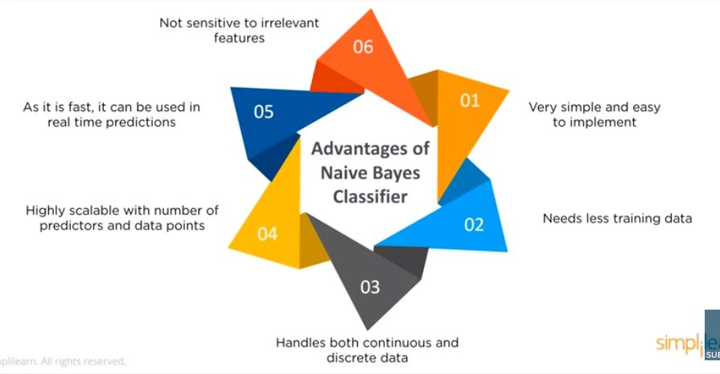
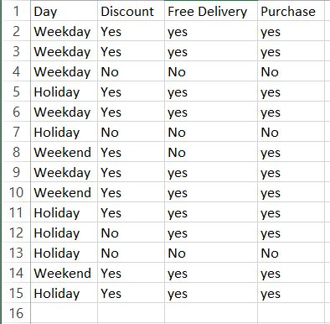
Naïve Bayes

Slide 3
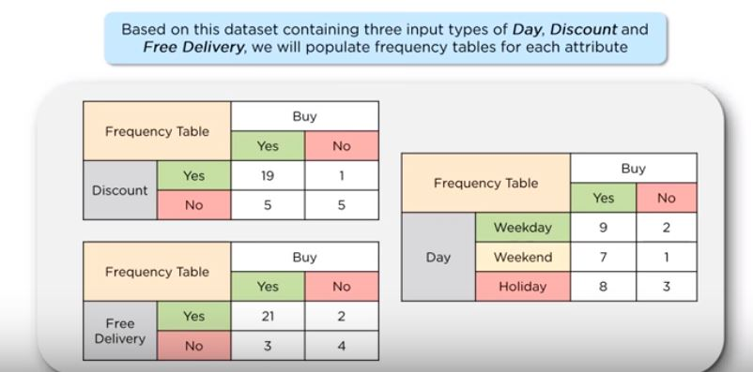
Independent variables
discount , free delivery, Day

Slide 4
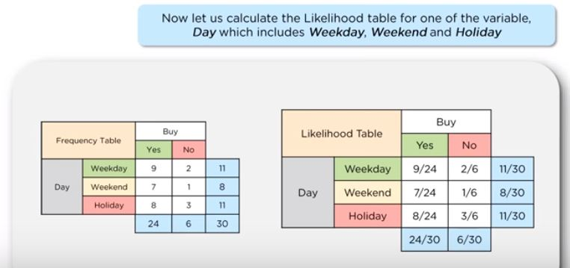
Likelihood
Probability
P(Buy No|Weekday)
(0.33*0.2)/0.37= 0.179
P(Weekday)
11/30
0.37
Probability
P(Buy |Weekday)
(9/24*24/30)/0.37=
0.375*0.8/0.37= 0.817
P(Weekday |Buy No) =2/6=0.33
P(not to buy)
6/30
0.2
The customer is more likely to buy during weekday

Slide 5
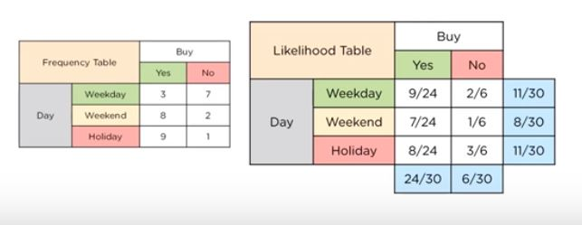
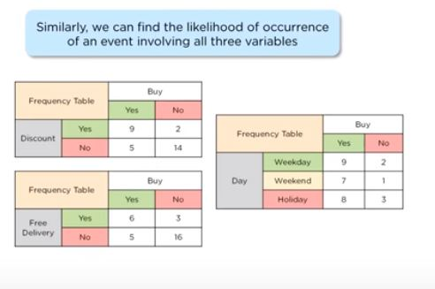
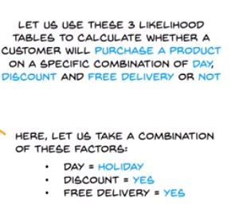
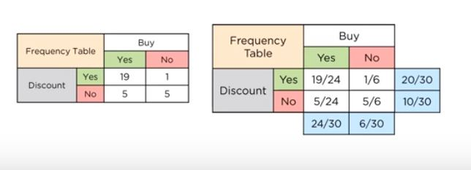
Likelihood Tables

Slide 6
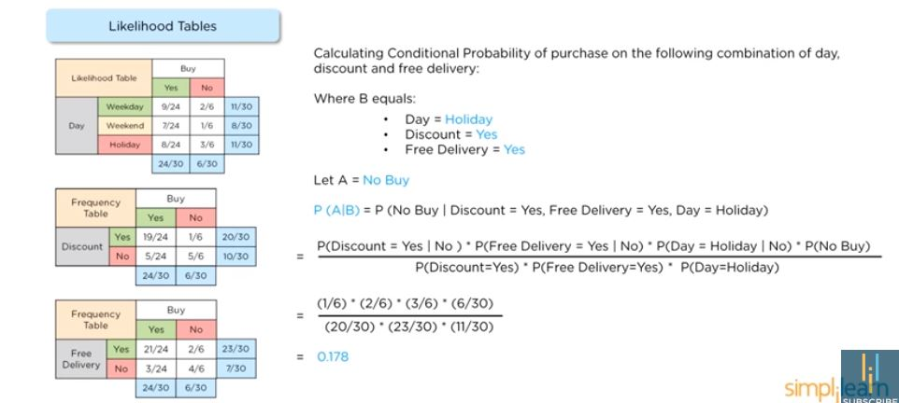
Likelihood Tables
Probability
Not To Buy

Slide 7
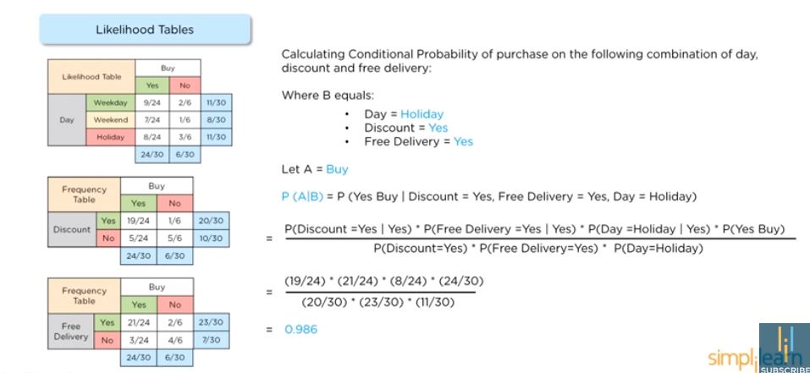
Normalize probabilities to get the likelihood of events
Probability
To Buy

Slide 8
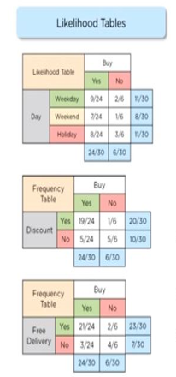
Conditional probability of purchase
Probability of Purchase =0.986
Probability of No purchase =0.178
Sum of probabilities = 0.986+0.178 =1.164
Likelihood of Purchase= 0.986/1.164 = 84.71 %
Likelihood of no purchase =0.178/1.164= 15.29 %
➔
An average customer will buy on a Holiday with discount and free delivery

Slide 9
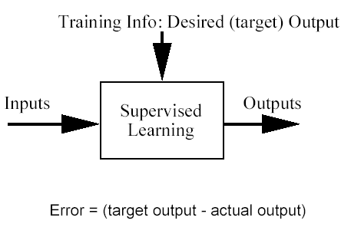
Classification problem
Training data: examples of the form (d,h(d))
where d are the data objects to classify (inputs)
and h(d) are the correct class info for d, h(d)∈{1,…K}
Goal: given d_{new}, provide h(d_{new})

Slide 10
Bayes Classifier
A probabilistic framework for solving classification problems
A, C random variables
Joint probability: Pr(A=a,C=c)
Conditional probability: Pr(C=c | A=a)
Relationship between joint and conditional probability distributions
Bayes Theorem:

Slide 11
Example of Bayes Theorem
Given:
A doctor knows that meningitis causes stiff neck 50% of the time
Prior probability of any patient having meningitis is 1/50,000
Prior probability of any patient having stiff neck is 1/20
If a patient has stiff neck, what’s the probability he/she has meningitis?

Slide 12
Bayes’ Rule & Diagnosis
Useful for assessing diagnostic probability from causal probability:
P(Cause|Effect) = P(Effect|Cause) ∗ P(Cause)
P(Effect)
Likelihood Prior
_{P(a|b) =} P(b|a)∗P(a)
P(b)
Posterior
Normalization

Slide 13
Bayesian Classifiers
Consider each attribute and class label as random variables
Given a record with attributes (A₁, A₂,…,A_{n})
Goal is to predict class C
Specifically, we want to find the value of C that maximizes P(C| A₁, A₂,…,A_{n} )
Can we estimate P(C| A₁, A₂,…,A_{n} ) directly from data?

Slide 14
Bayesian Classifiers
Approach:
compute the posterior probability P(C | A₁, A₂, …, A_{n}) for all values of C using the Bayes theorem
Choose value of C that maximizes P(C | A₁, A₂, …, A_{n})
Equivalent to choosing value of C that maximizes P(A₁, A₂, …, A_{n}|C) P(C)
How to estimate P(A₁, A₂, …, A_{n} | C )?

Slide 15
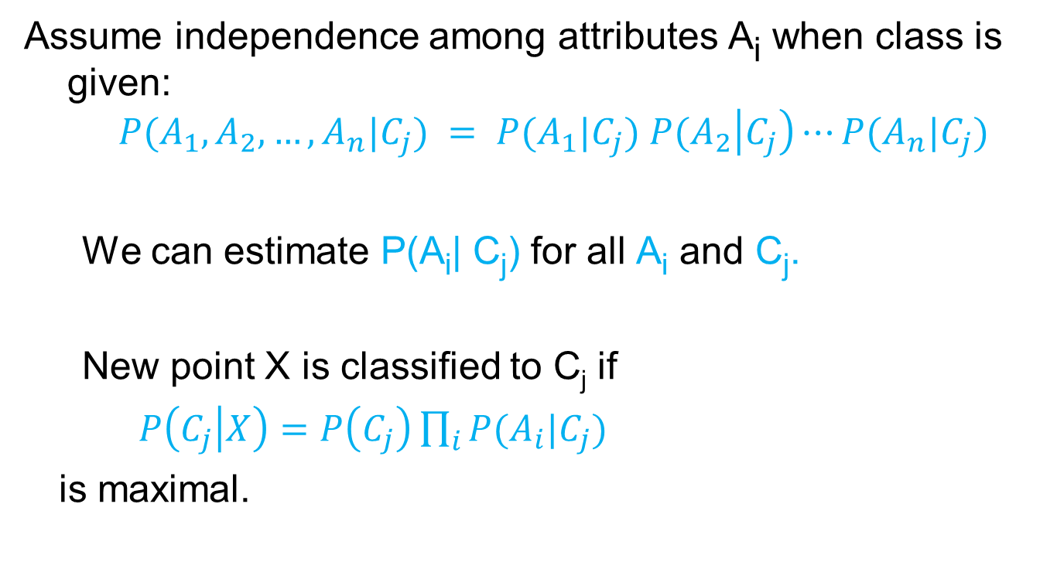
Naïve Bayes Classifier

Slide 16
How to Estimate Probabilities from Data?
Class: P(C) = N_{c}/N
e.g., P(No) = 7/10, P(Yes) = 3/10
For discrete attributes: P(A_{i} | C_{k}) = |A_{ik}|/ N_{c}
where |A_{ik}| is number of instances having attribute A_{i} and belongs to class C_{k}
Examples:
P(Status=Married|No) = 4/7 P(Refund=Yes|Yes)=0
k

Slide 17
How to Estimate Probabilities from Data?
For continuous attributes:
Discretize the range into bins
one ordinal attribute per bin
violates independence assumption
Two-way split: (A < v) or (A > v)
choose only one of the two splits as new attribute
Probability density estimation:
Assume attribute follows a normal distribution
Use data to estimate parameters of distribution (e.g., mean and standard deviation)
Once probability distribution is known, can use it to estimate the conditional probability P(A_{i}|c)

Slide 18
How to Estimate Probabilities from Data?
Normal distribution:
One for each (A_{i},c_{i}) pair
For (Income, Class=No):
If Class=No
sample mean = 110
sample variance = 2975

Slide 19
Example of Naïve Bayes Classifier
Given a Test Record:
P(X|Class=No) = P(Refund=No|Class=No) × P(Married| Class=No) × P(Income=120K| Class=No) = 4/7 × 4/7 × 0.0072 = 0.0024
P(X|Class=Yes) = P(Refund=No| Class=Yes) × P(Married| Class=Yes) × P(Income=120K| Class=Yes) = 1 × 0 × 1.2 × 10⁻⁹ = 0
Since P(X|No)P(No) > P(X|Yes)P(Yes)
Therefore P(No|X) > P(Yes|X) => Class = No

Slide 20
Naïve Bayes Classifier
If one of the conditional probability is zero, then the entire expression becomes zero
Probability estimation:
N_{i}: number of attribute values for attribute A_{i}
p: prior probability
m: parameter

Slide 21
Example of Naïve Bayes Classifier
A: attributes
M: mammals
N: non-mammals
P(A|M)P(M) > P(A|N)P(N)
=> Mammals

Slide 22
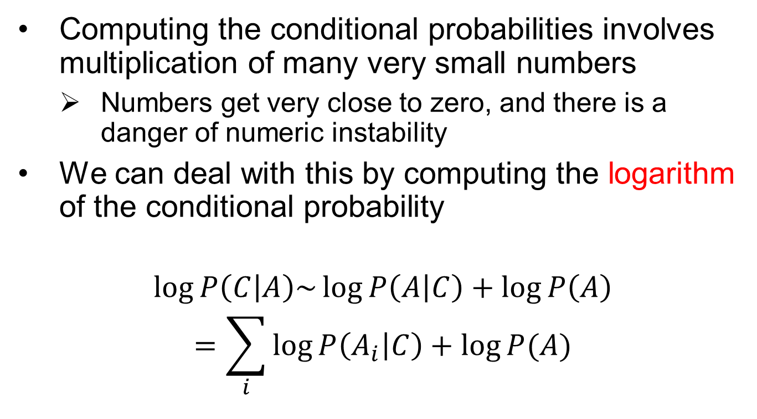
Implementation details

Slide 23
Naïve Bayes
Robust to isolated noise points
Handle missing values by ignoring the instance during probability estimate calculations
Robust to irrelevant attributes
Independence assumption may not hold for some attributes
Use other techniques such as Bayesian Belief Networks (BBN)
Naïve Bayes can produce a probability estimate, but it is usually a very biased one
Logistic Regression is better for obtaining probabilities.

Slide 24



Generative vs Discriminative models
Naïve Bayes is a type of a generative model
Generative process:
First pick the category of the record
Then given the category, generate the attribute values from the distribution of the category
Conditional independence given C
We use the training data to learn the distribution of the values in a class
C

Slide 25
Generative vs Discriminative models
Logistic Regression and SVM are discriminative models
The goal is to find the boundary that discriminates between the two classes from the training data
In order to classify the language of a document, you can
Either learn the two languages and find which is more likely to have generated the words you see
Or learn what differentiates the two languages.

Slide 26
About the Bayesian framework
Allows us to combine observed data and prior knowledge
Provides practical learning algorithms
It is a generative (model based) approach, which offers a useful conceptual framework
This means that any kind of objects (e.g. time series, trees, etc.) can be classified, based on a probabilistic model specification

Slide 27
Example. ‘Play Tennis’ data
Notes:
27

Slide 28
Example
Learning Phase
Outlook | Play=Yes | Play=No
Sunny | 2/9 | 3/5
Overcast | 4/9 | 0/5
Rain | 3/9 | 2/5
Temperature | Play=Yes | Play=No
Hot | 2/9 | 2/5
Mild | 4/9 | 2/5
Cool | 3/9 | 1/5
Humidity | Play=Yes | Play=No
High | 3/9 | 4/5
Normal | 6/9 | 1/5
Wind | Play=Yes | Play=No
Strong | 3/9 | 3/5
Weak | 6/9 | 2/5
P(Play=Yes) = 9/14
P(Play=No) = 5/14

Slide 29
Example :Test Phase
Given a new instance, predict its label
x’=(Outlook=Sunny, Temperature=Cool, Humidity=High, Wind=Strong)
Look up tables achieved in the learning phrase
Decision making with the MAP rule
P(Outlook=Sunny|Play=Yes) = 2/9
P(Temperature=Cool|Play=Yes) = 3/9
P(Huminity=High|Play=Yes) = 3/9
P(Wind=Strong|Play=Yes) = 3/9
P(Play=Yes) = 9/14
P(Outlook=Sunny|Play=No) = 3/5
P(Temperature=Cool|Play==No) = 1/5
P(Huminity=High|Play=No) = 4/5
P(Wind=Strong|Play=No) = 3/5
P(Play=No) = 5/14
P(Yes|x’) ≈ [P(Sunny|Yes)P(Cool|Yes)P(High|Yes)P(Strong|Yes)]P(Play=Yes) = 0.0053
P(No|x’) ≈ [P(Sunny|No) P(Cool|No)P(High|No)P(Strong|No)]P(Play=No) = 0.0206
Given the fact P(Yes|x’) < P(No|x’), we label x’ to be “No”.

Slide 30
Problem: Players will play if weather is sunny. Is this statement is correct?
We can solve it using above discussed method of posterior probability.
P(Yes | Sunny) = P( Sunny | Yes) * P(Yes) / P (Sunny)
Here we have P (Sunny |Yes) = 3/9 = 0.33, P(Sunny) = 5/14 = 0.36, P( Yes)= 9/14 = 0.64
Now, P (Yes | Sunny) = 0.33 * 0.64 / 0.36 = 0.60, which has higher probability.
Naive Bayes uses a similar method to predict the probability of different class based on various attributes. This algorithm is mostly used in text classification and with problems having multiple classes.

Slide 31
How Naive Bayes algorithm works?
Step 1: Convert the data set into a frequency table
Step 2: Create Likelihood table by finding the probabilities like Overcast probability = 0.29 and probability of playing is 0.64.
Step 3: Now, use Naive Bayesian equation to calculate the posterior probability for each class. The class with the highest posterior probability is the outcome of prediction.

Slide 32
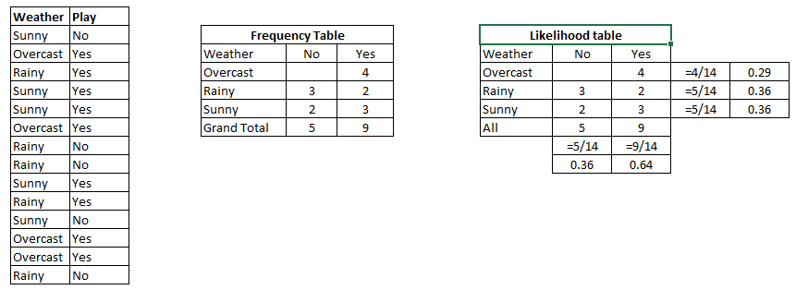
Frequency Table, Likelihood

Slide 33
#Import Library of Gaussian Naive Bayes model
from sklearn.naive_bayes import GaussianNB
import numpy as np
#assigning predictor and target variables
x= np.array([[-3,7],[1,5], [1,2], [-2,0], [2,3], [-4,0], [-1,1], [1,1], [-2,2], [2,7], [-4,1], [-2,7]])
Y = np.array([3, 3, 3, 3, 4, 3, 3, 4, 3, 4, 4, 4])
#Create a Gaussian Classifier
model = GaussianNB()
# Train the model using the training sets
model.fit(x, y)
#Predict Output
predicted= model.predict([[1,2],[3,4]])
print predicted
Output: ([3,4])

Slide 34
Review :Bayesian Classification: Why?
A statistical classifier: performs probabilistic prediction, i.e., predicts class membership probabilities
Foundation: Based on Bayes’ Theorem.
Performance: A simple Bayesian classifier, naïve Bayesian classifier, has comparable performance with decision tree and selected neural network classifiers
Incremental: Each training example can incrementally increase/decrease the probability that a hypothesis is correct — prior knowledge can be combined with observed data
Standard: Even when Bayesian methods are computationally intractable, they can provide a standard of optimal decision making against which other methods can be measured

Slide 35
Bayesian Theorem: Basics
Let X be a data sample (“evidence”): class label is unknown
Let H be a hypothesis that X belongs to class C
Classification is to determine P(H|X), the probability that the hypothesis holds given the observed data sample X
P(H) (prior probability), the initial probability
E.g., X will buy computer, regardless of age, income, …
P(X): probability that sample data is observed
P(X|H) (posteriori probability), the probability of observing the sample X, given that the hypothesis holds
E.g., Given that X will buy computer, the prob. that X is 31..40, medium income

Slide 36
Bayesian Theorem
Given training data X, posteriori probability of a hypothesis H, P(H|X), follows the Bayes theorem
Informally, this can be written as
posteriori = likelihood x prior/evidence
Predicts X belongs to C₂ iff the probability P(C_{i}|X) is the highest among all the P(C_{k}|X) for all the k classes
Practical difficulty: require initial knowledge of many probabilities, significant computational cost

Slide 37
Towards Naïve Bayesian Classifier
Let D be a training set of tuples and their associated class labels, and each tuple is represented by an n-D attribute vector X = (x₁, x₂, …, x_{n})
Suppose there are m classes C₁, C₂, …, C_{m}.
Classification is to derive the maximum posteriori, i.e., the maximal P(C_{i}|X)
This can be derived from Bayes’ theorem
Since P(X) is constant for all classes, only
needs to be maximized

Slide 38
Avoiding the 0-Probability Problem
Naïve Bayesian prediction requires each conditional prob. be non-zero. Otherwise, the predicted prob. will be zero
Ex. Suppose a dataset with 1000 tuples, income=low (0), income= medium (990), and income = high (10),
Use Laplacian correction (or Laplacian estimator)
Adding 1 to each case
Prob(income = low) = 1/1003
Prob(income = medium) = 991/1003
Prob(income = high) = 11/1003
The “corrected” prob. estimates are close to their “uncorrected” counterparts

Slide 39
Avoiding the 0-Probability Problem
Naïve Bayesian prediction requires each conditional prob. be non-zero. Otherwise, the predicted prob. will be zero
Ex. Suppose a dataset with 1000 tuples, income=low (0), income= medium (990), and income = high (10),
Use Laplacian correction (or Laplacian estimator)
Adding 1 to each case
Prob(income = low) = 1/1003
Prob(income = medium) = 991/1003
Prob(income = high) = 11/1003
The “corrected” prob. estimates are close to their “uncorrected” counterparts

Slide 40
Naïve Bayesian Classifier: Comments
Advantages
Easy to implement
Good results obtained in most of the cases
Disadvantages
Assumption: class conditional independence, therefore loss of accuracy
Practically, dependencies exist among variables
E.g., hospitals: patients: Profile: age, family history, etc.
Symptoms: fever, cough etc., Disease: lung cancer, diabetes, etc.
Dependencies among these cannot be modeled by Naïve Bayesian Classifier
How to deal with these dependencies?
Bayesian Belief Networks

Slide 41
Naïve Bayesian Classifier: Training Dataset
Class:
C1:buys_computer = ‘yes’
C2:buys_computer = ‘no’
Data sample
X = (age <=30,
Income = medium,
Student = yes
Credit_rating = Fair)

Slide 42
Naïve Bayesian Classifier: An Example
P(C_{i}): P(buys_computer = “yes”) = 9/14 = 0.643
P(buys_computer = “no”) = 5/14= 0.357
Compute P(X|C_{i}) for each class
P(age = “<=30” | buys_computer = “yes”) = 2/9 = 0.222
P(age = “<= 30” | buys_computer = “no”) = 3/5 = 0.6
P(income = “medium” | buys_computer = “yes”) = 4/9 = 0.444
P(income = “medium” | buys_computer = “no”) = 2/5 = 0.4
P(student = “yes” | buys_computer = “yes) = 6/9 = 0.667
P(student = “yes” | buys_computer = “no”) = 1/5 = 0.2
P(credit_rating = “fair” | buys_computer = “yes”) = 6/9 = 0.667
P(credit_rating = “fair” | buys_computer = “no”) = 2/5 = 0.4
X = (age <= 30 , income = medium, student = yes, credit_rating = fair)
P(X|C_{i}) : P(X|buys_computer = “yes”) = 0.222 x 0.444 x 0.667 x 0.667 = 0.044
P(X|buys_computer = “no”) = 0.6 x 0.4 x 0.2 x 0.4 = 0.019
P(X|C_{i})*P(C_{i}) : P(X|buys_computer = “yes”) * P(buys_computer = “yes”) = 0.028
P(X|buys_computer = “no”) * P(buys_computer = “no”) = 0.007
Therefore, X belongs to class (“buys_computer = yes”)

